Slide 1

Handwritten Digit Recognition with Deep Learning (128x128 Input)
PRESENTED BY:
Aryan Dhull(20221CSD0108)
Vishwajeet(20221CSD0126)
M.Akshay(20221CSD0139)

Slide 2

Handwritten Digit Recognition with Deep Learning (128x128 Input)
This project implements a Convolutional Neural Network (CNN) to classify handwritten digits from the MNIST dataset using 128x128 images. It covers data preprocessing, model training, evaluation, visualization, enhanced custom image prediction, and model saving/loading to avoid retraining.
The approach leverages Python, TensorFlow/Keras, and advanced image processing libraries to improve digit recognition accuracy and usability.
Notes:
2

Slide 3
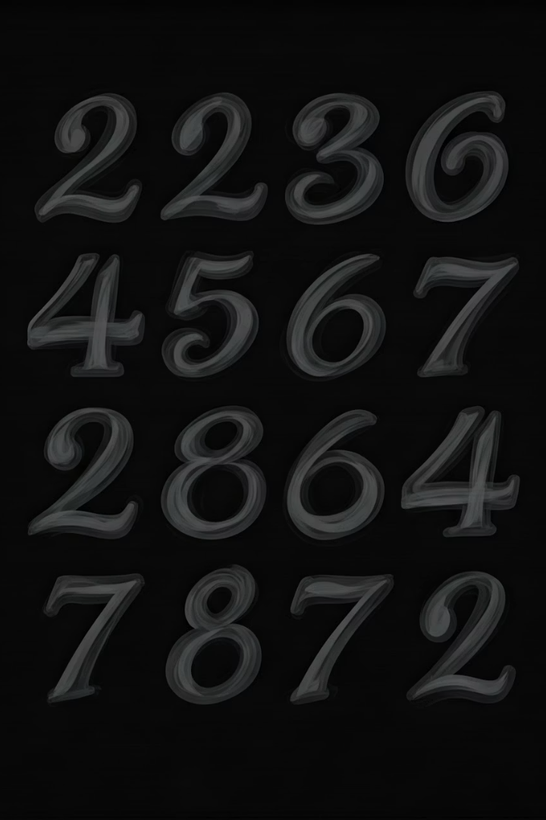
Data Loading and Preprocessing
Dataset Preparation
MNIST dataset with 60,000 training and 10,000 testing grayscale images originally 28x28 pixels.
Images resized to 128x128, normalized to [0,1], and reshaped to include channel dimension (128x128x1).
Label Encoding
Labels converted to one-hot encoded format for 10 digit classes (0–9).
Training data shape: (60000, 128, 128, 1); Test data shape: (10000, 128, 128, 1).
Notes:
3

Slide 4
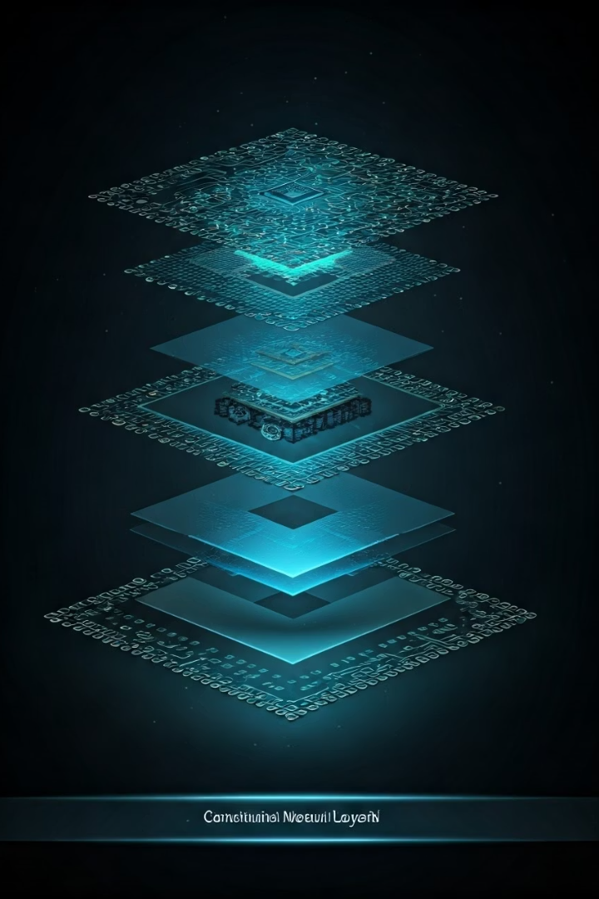
Building the CNN Model
Architecture
Regularization
Two Conv2D layers with ReLU activation followed by MaxPooling2D to reduce spatial dimensions.
Dropout layer with 0.5 rate to prevent overfitting.
Output
Dense layers with 128 units and final softmax layer with 10 units for digit classification.
Notes:
4

Slide 5
Training and Saving the Model
Training Setup
Performance
Model trained for 5 epochs with batch size 64 and 20% validation split.
Validation accuracy reached approximately 98.6% by the final epoch.
Adam optimizer and categorical crossentropy loss used.
Model saved as mnist_cnn_128x128_model.h5 for reuse without retraining.
Notes:
5

Slide 6



Model Evaluation and Metrics
Classification Report
High precision and recall (~0.98–0.99) across all digit classes.
2
Test Accuracy
Consistent F1-scores indicating balanced performance.
Achieved 98.47% accuracy on the test set.
1
Confusion Matrix
3
Visualizes correct and incorrect predictions, highlighting model strengths and areas for improvement.
Notes:
6

Slide 7
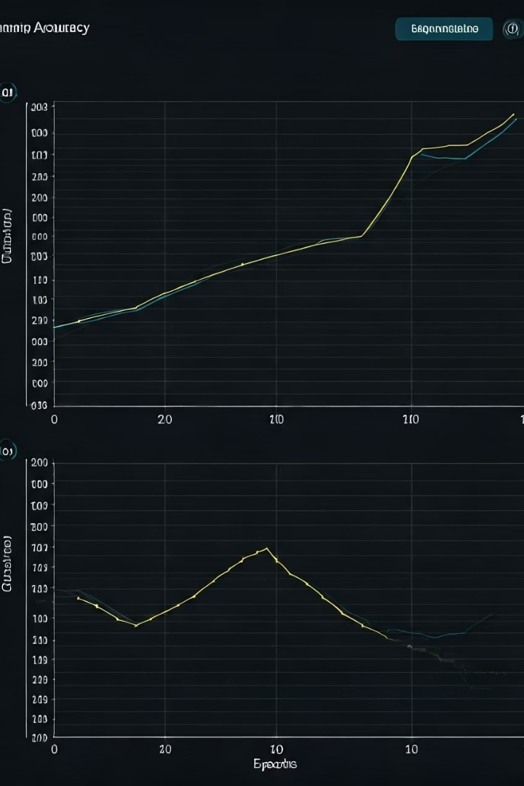



Training Progress Visualization
Accuracy Trends
Training and validation accuracy steadily improve, reaching near 99%.
Loss Trends
Training and validation loss decrease consistently, indicating effective learning.
Overfitting Check
No significant overfitting observed; validation metrics closely follow training.
Notes:
7

Slide 8

Custom Image Prediction with Enhanced Preprocessing
Preprocessing Steps
Resize custom images to 256x256 for detail retention, apply sharpening filter, and adaptive thresholding for contrast.
Model Prediction
Preprocessed image resized to 128x128 and normalized before prediction using the saved CNN model.
Visualization
Displays preprocessed image alongside predicted digit for user verification.
Notes:
8

Slide 9

Conclusion and Next Steps
Key Outcomes
Achieved ~98–99% test accuracy with a CNN on 128x128 MNIST images.
Implemented enhanced preprocessing for custom image prediction and model persistence.
Future Directions
Experiment with hyperparameters like learning rate and dropout.
Apply data augmentation to improve robustness.
Test on diverse custom handwritten digits.
Deploy model with Streamlit for interactive use.
Notes:
9

Slide 10
THANK YOU
Notes:
9

